Slide 1

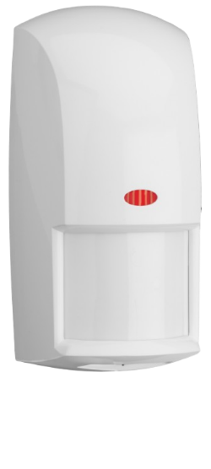
Outdoor
motion detector

Slide 2
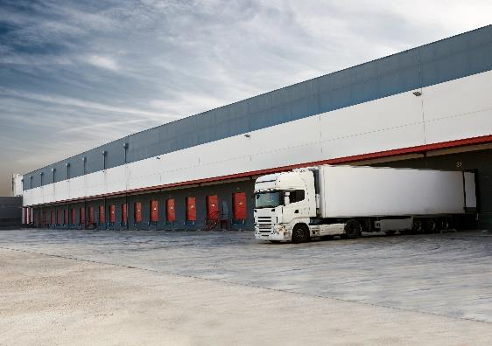


Industries
Outdoor motion detector
The OD850 Series TriTech motion detectors are for use outdoors and in other harsh environments. Weather and vandal resistant, ideal for parking lots, loading docks or residential.
Loading docks
Parking lots
Residential

Slide 3

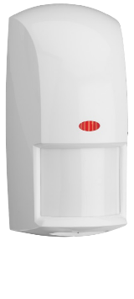

Features
Outdoor motion detector
Advanced signal processing to minimize false alarms caused by:
  Hot/cold drafts
  Sunlight or lightning
  Repetitive small movements like trees
Selectable detection sensitivity to suit different applications.
Sealed optical chamber prevents drafts and insects from affecting the detector.
Adjustable timed relay output from 2 seconds to 10 minutes
MEMS sensor inside

Slide 4


Specifications
Outdoor motion detector
Type | Outdoor TriTech
Commercial Type Number | OD850-F1E
Coverage / range | 15 m x 15 m (50 ft x 50 ft)
Mounting height | 2.1 m to 2.7 m (7 ft to 9 ft)
Operating temperature | -35°C to +54°C -31°F to +130°F
Environmental rate | IP54
Tamper | NC Cover
Sensitivity adjustment | ◾
Certifications | CSP, CE, FCC, UL
Warranty | 8 years
◾ available
– not available

